Slide 1


Mobile Phone Security
Dr. Digvijaysinh Rathod
Associate Dean
School of Cyber Security and Digital Forensics
National Forensic Sciences University
digvijay.rathod@nfsu.ac.in

Slide 2
Session - I
Session – I
Introduction to Android
Android Architecture
Android Run Time
Dr. Digvijaysinh Rathod

Slide 3


Android Application Security Pen-Testing
iOS Application Security Pen-Testing
digvijay.rathod@gfsu.edu.in

Slide 4

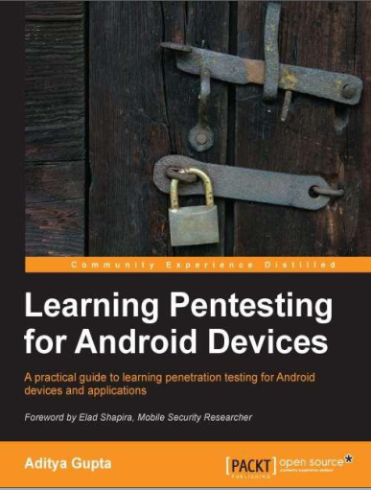
Reference
digvijay.rathod@gfsu.edu.in

Slide 5
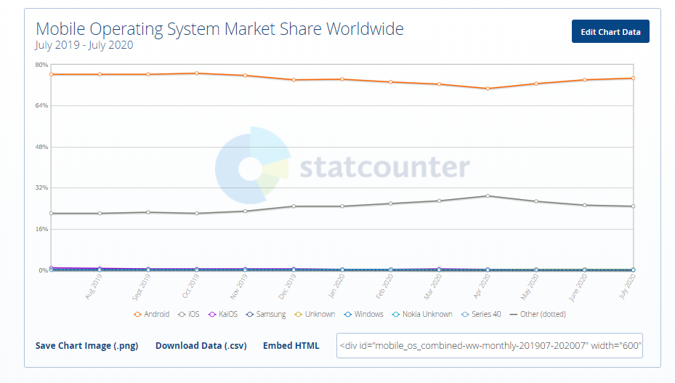
Mobile Operating System Market Share Worldwide
Ref: https://gs.statcounter.com/os-market-share/mobile/worldwide
Dr. Digvijaysinh Rathod

Slide 6
Introduction to Android
Android is an open-source operating system based on Linux with a Java and kotlin programming interface for mobile devices such as Smartphone (Touch Screen Devices who supports Android OS) as well for Tablets too.
Android was developed by the Open Handset Alliance (OHA), which is led by Google.
The Open Handset Alliance (OHA) is a consortium of multiple companies like Samsung, Sony, Intel and many more to provide services and deploy handsets using the android platform.
Dr. Digvijaysinh Rathod

Slide 7
Introduction to Android
In 2007, Google released a first beta version of the Android Software Development Kit (SDK) and the first commercial version of Android 1.0 (with name Alpha), was released in September 2008.
In 2012, Google released another version of android, 4.1 Jelly Bean.
In 2014, Google announced another Latest Version, 5.0 Lollipop.
Latest release10/August 3, 2020 and on the way to release Android 11.
Dr. Digvijaysinh Rathod

Slide 8
The Android architecture
Any operating system (desktop or mobile) takes responsibility for managing the resources of the system and provides a way for applications to talk to hardware or physical components in order to accomplish certain tasks.
OS manage mobile phones, manages memory and processes, enforces security, takes care of networking issues
Dr. Digvijaysinh Rathod

Slide 9
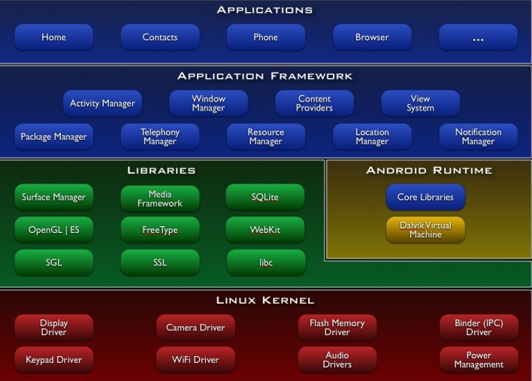
The Android architecture
The Android operating system consists of a stack of layers running on top of each other.
Dr. Digvijaysinh Rathod

Slide 10
The Android architecture
The Linux kernel:
Provides a level of abstraction between the device hardware and the upper layers.
Kernel contains drivers to understand the hardware instruction.
The drivers in the kernel control the underlying hardware.
As shown in the preceding figure, the kernel contains drivers related to Wi-Fi, Bluetooth, USB, audio, display, and so on.
Such as process management, memory management, security, and networking, are managed by Linux kernel
Dr. Digvijaysinh Rathod

Slide 11
The Android architecture
Libraries:
On top of Linux kernel are Android's native libraries.
It is with the help of these libraries that the device handles different types of data.
These libraries are written in the C or C++ programming languages and are specific to a particular hardware.
For example, the media framework library supports the recording and playback of audio, video and picture formats.
Dr. Digvijaysinh Rathod

Slide 12
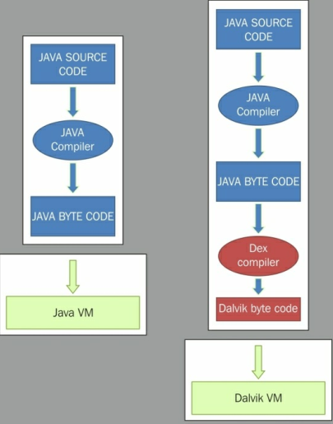
The Android Run Time
Dalvik virtual machine:
.Class
.dex
Dalvik Executable
Dr. Digvijaysinh Rathod

Slide 13
The Android architecture
Dalvik byte code :
Dalvik byte code is an optimized byte code suitable for low-memory and low-processing environments.
Also, note that JVM's byte code consists of one or more .class files, depending on the number of Java files that are present in an application,
but Dalvik byte code is composed of only one .dex file.
Dr. Digvijaysinh Rathod

Slide 14
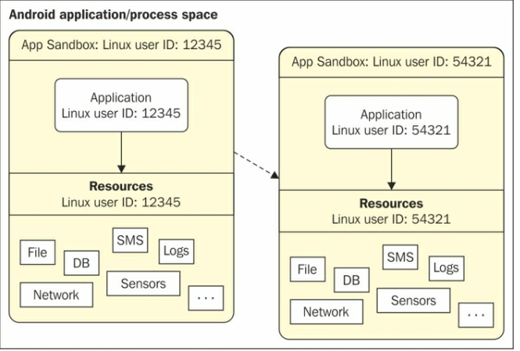
Android security
Application sandboxing :
Two applications on different processes on with different UID's
Dr. Digvijaysinh Rathod

Slide 15
Android security
Application sandboxing :
In order to isolate applications from each other, Android takes advantage of the Linux user-based protection model.
In Linux systems, each user is assigned a unique user ID (UID) and users are segregated so that one user does not access the data of another user.
All resources under a particular user are run with the same privileges. Similarly, each Android application is assigned a UID and is run as a separate process.
This application sandboxing is done at the kernel level. it applies to both native applications and OS applications
Dr. Digvijaysinh Rathod

Slide 16
Mobile Phone Security
Dr. Digvijaysinh Rathod
Associate Professor
(Cyber Security and Digital Forensics)
Institute of Forensic Science
Gujarat Forensic Sciences University
digvijay.rathod@gfsu.edu.in

